Slide 1
GitHub: Repositories & Portfolio Websites
James R. Bradley

Slide 2
GitHub
We will be interacting with github.com
git
Version control software
hub
The effective center of activity, region, or network
Source: google.com
github.com
permits use of git…
As a hub for many people to download and contribute to files

Slide 3
GitHub Session
Repositories on github.com
Called “repos”
“Pages” web site
Free
Publish a portfolio of your work
Useful in your job search

Slide 4
GitHub Repositories (Repos)

Slide 5
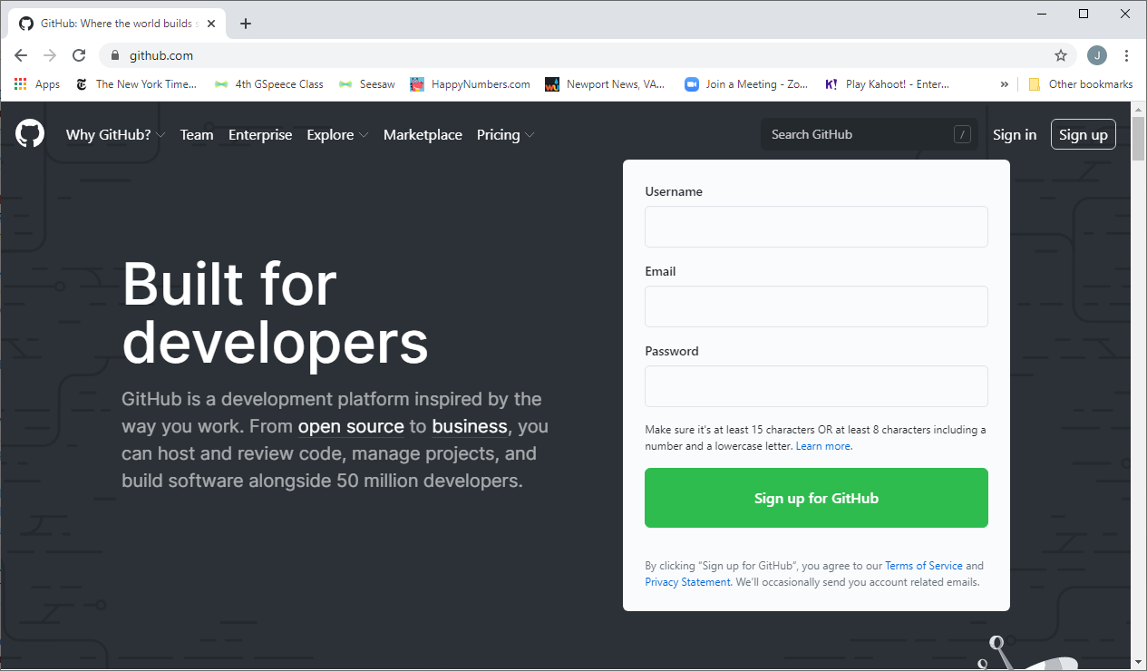
Sign Up for GitHub
Create account at https://github.com/

Slide 6
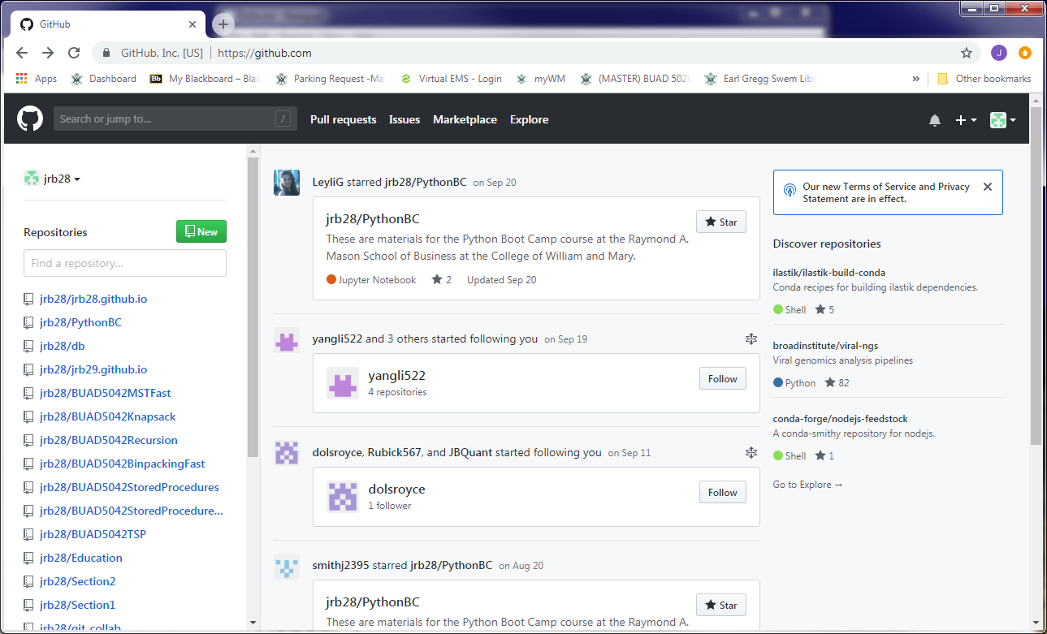
GitHub
Here is my github.com page
Multiple repositories (repos)
For distributing files… and more as we will discuss

Slide 7
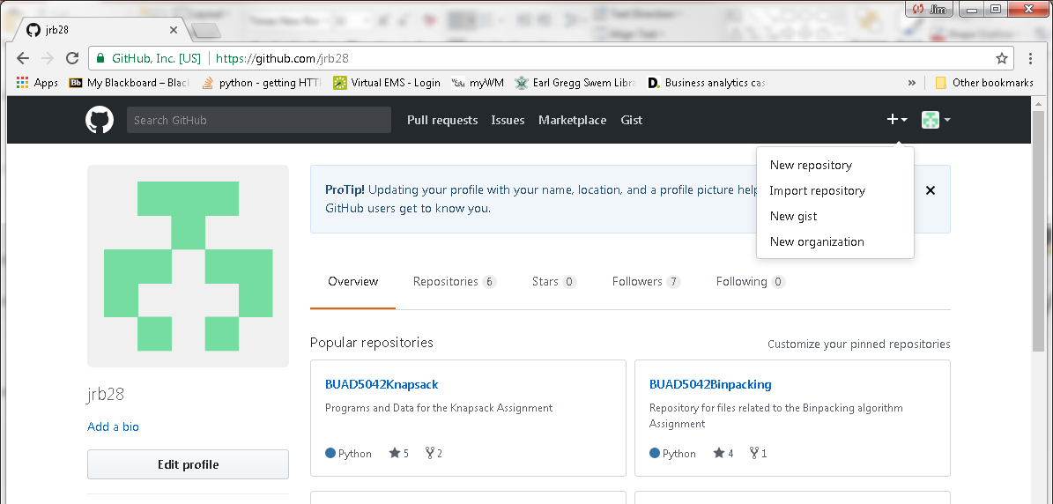
GitHub Repositories
Create a repository

Slide 8
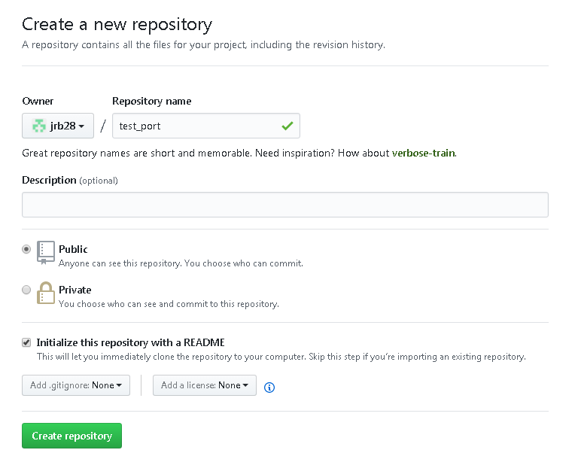
GitHub Repositories
Choose Public repository (free)
Choose Initialize this repository with a README
Customize README.md

Slide 9
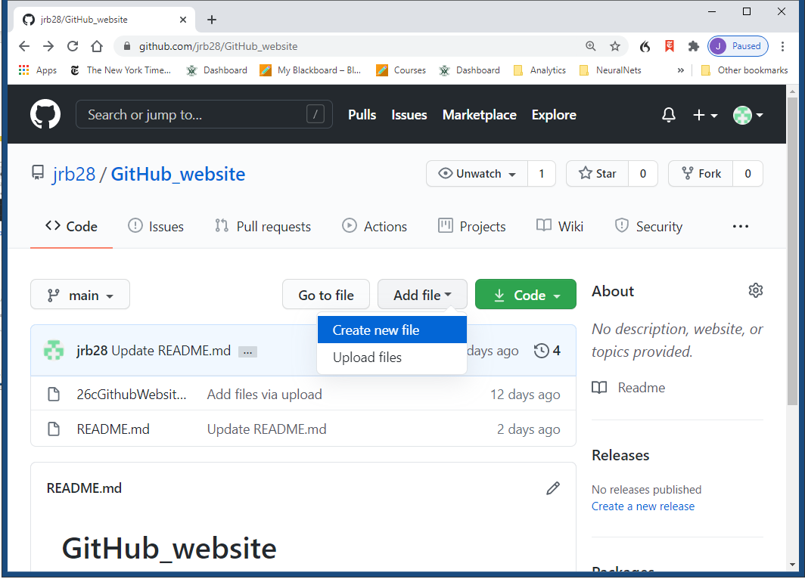
GitHub Repositories
Method 1 for uploading files
Click on Add File>Upload Files
Select files
Change commit message if desired
Click on Commit Changes
Method 2
Drag files onto repo page

Slide 10
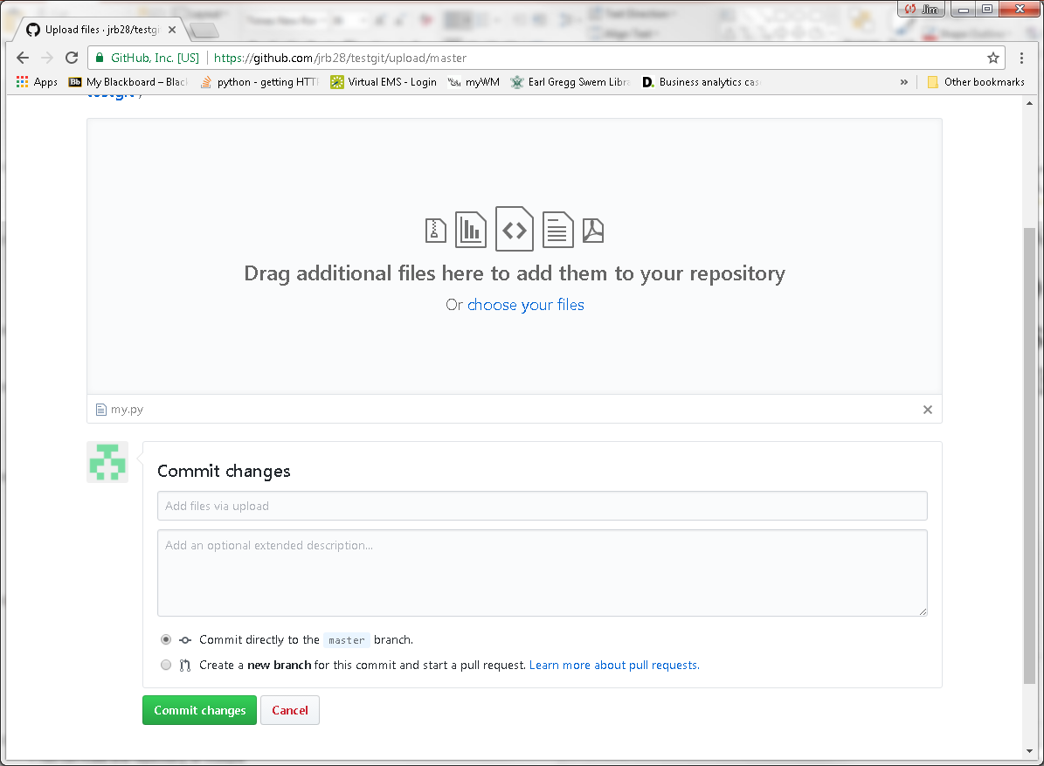
GitHub Repositories

Slide 11
Portfolio in GitHub Repository
Repos can be a part of your portfolio
Publish all code and documents on a single project in a repo
Code, Jupyter notebooks, presentations, reports, etc.
Jupyter notebooks in repos are rendered as html web pages
Opportunity to show your work and explain what you did
Use multiple repos
Each focuses on a different topics, job, or project
Organize your files within folders for neatness
All code in a folder
readme.md document in root folder

Slide 12
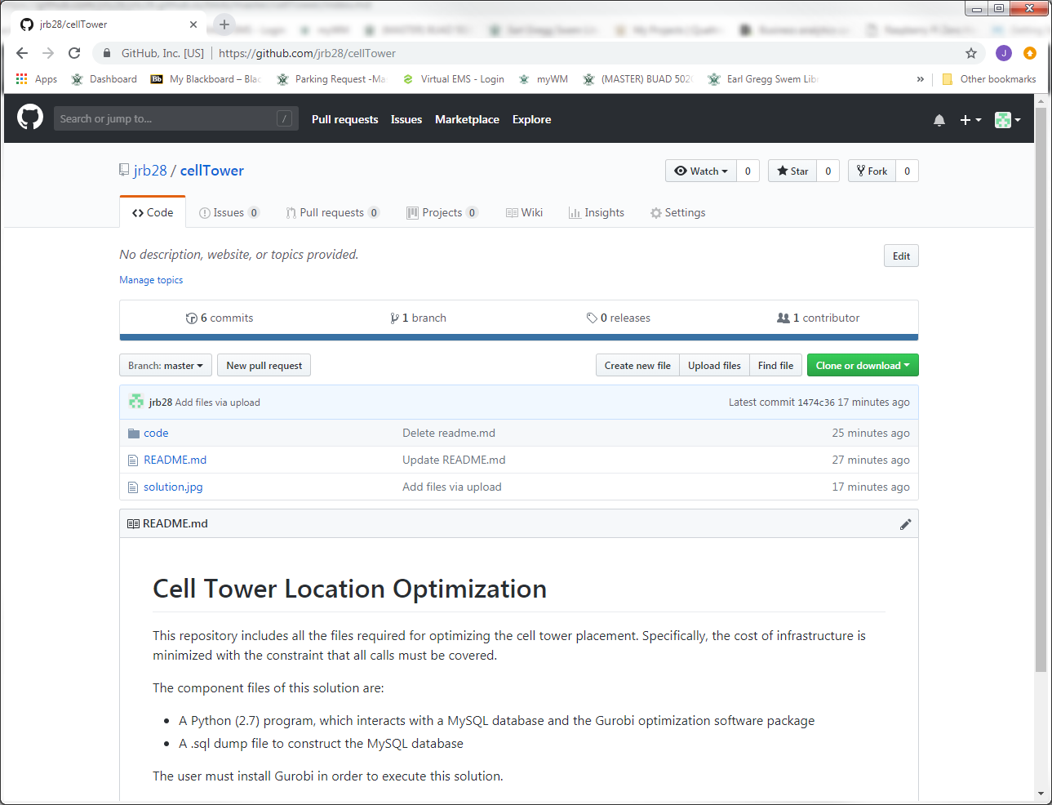
Portfolio in GitHub Repository
Example GitHub repo

Slide 13
GitHub Personal “Pages” Web Sites
Tour an Example
Setting up the website
Creating content

Slide 14
https://bbailab.github.io/nn/
Small, but some ideas
Examples
Landing pages, bullets, headings, etc.
Links to other pages
Images
Videos
Repos with code
Comments
Available templates are not sufficiently aesthetic
A little difficult to work with

Slide 15
GitHub Personal “Pages” Web Sites
Tour an Example
Setting up the website
Creating content

Slide 16
Setting Up the Website
Create repository for web site
Enable web publishing
Choose template
Personalize template
Add content to web site
Web pages
Images: pictures, graphs
Videos: embedded and links to YouTube
Links to GitHub repos

Slide 17
Setting Up the Website
Create a GitHub repository with this name:
username.github.io
My username/account:
git-demo-session
Your URL will be
username.github.io
Edit your site here
github.com/username/username.github.io

Slide 18
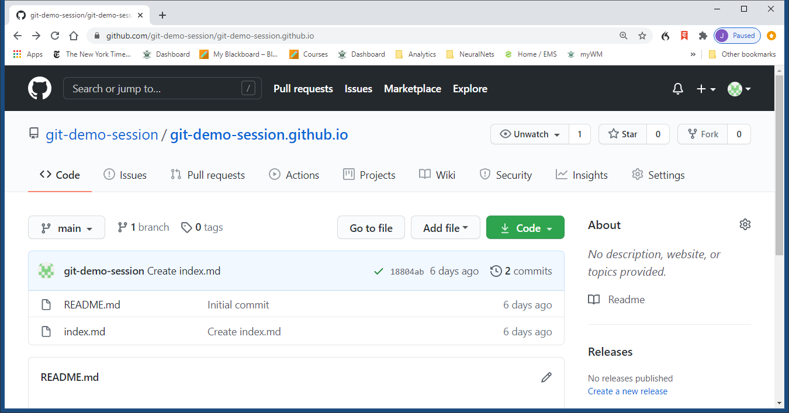
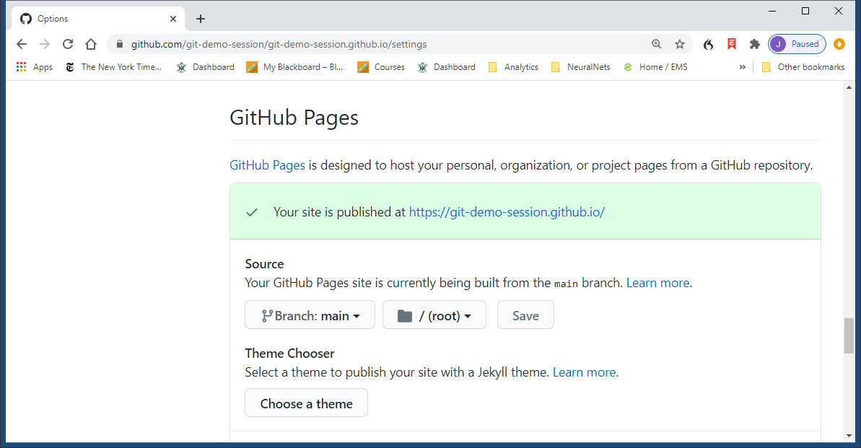
Setting Up the Website
Mode 1—Fast, less flexibility
Click on Settings
Scroll to GitHub Pages section
Set Source to main Branch
Or branch indicated in repo
Click on Choose a theme

Slide 19
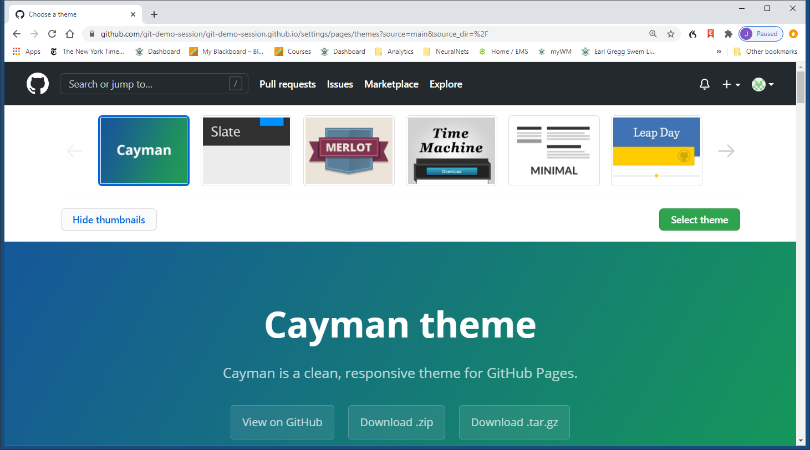
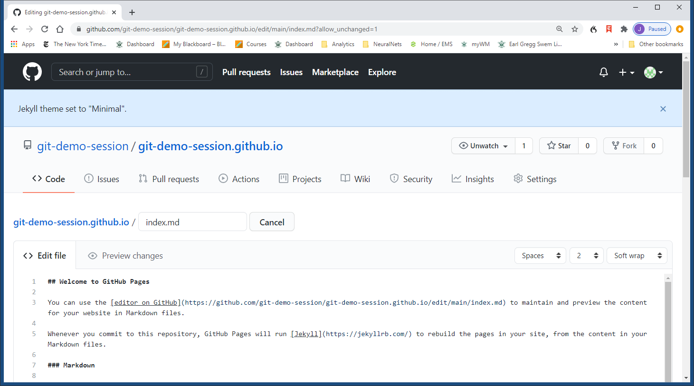
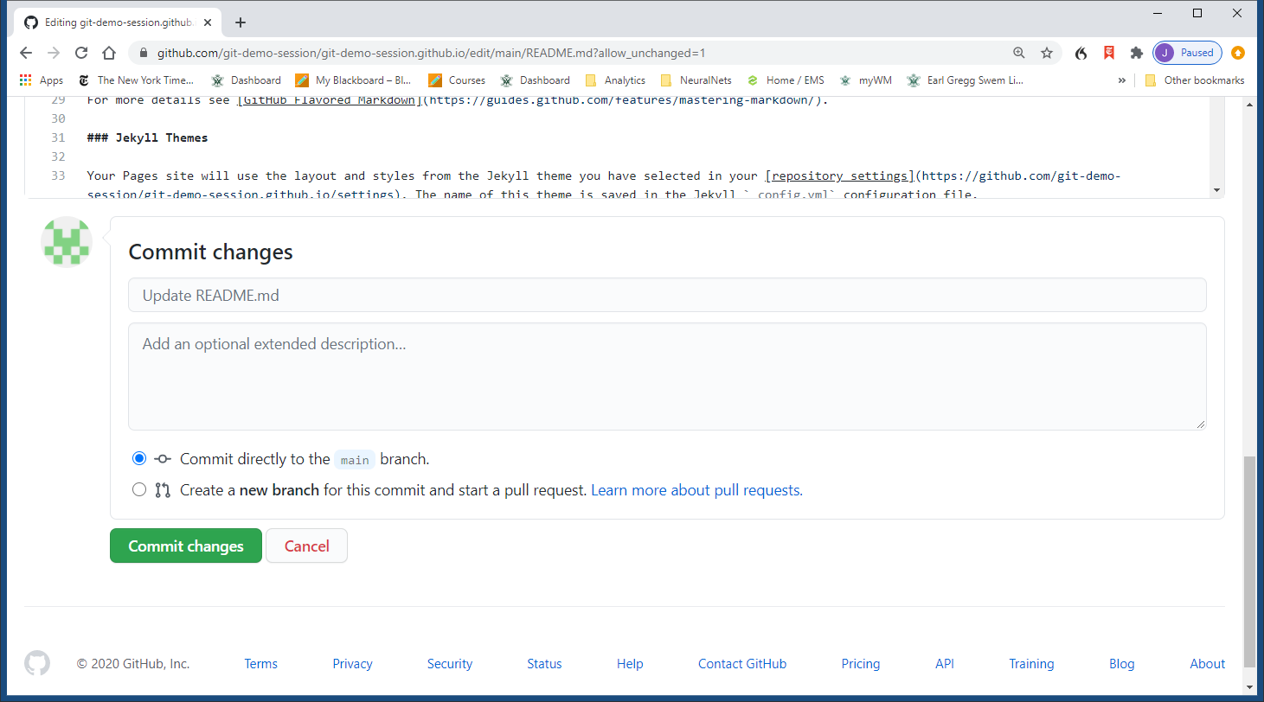
Setting Up the Website
Mode 1 (continued)
Choose theme
Scroll through themes and click on one to select
Click on Select theme button
Commit changes

Slide 20
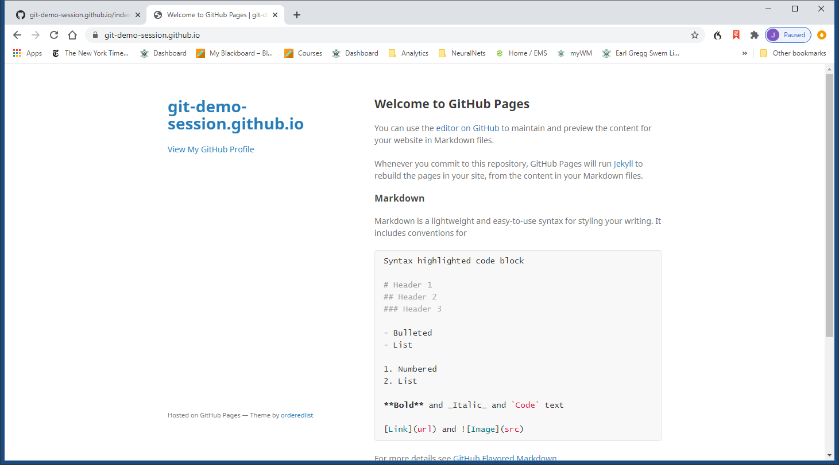
Setting Up the Website
Mode 1 (continued)
Navigate to username.github.io
Requires some time to compile

Slide 21
Setting Up the Website
Go to username.github.io
GitHub/Jekyll converts markdown files (.md) to HTML
index.md creates the default web page index.html
Text file: edit as you wish
*.html
*.html
index.md
index.html
Jekyll
Web Site Generator
HTML
_config.yml
/_sass/*.scss
Sass (Syntactically Awesome StyleSheets)
CSS (Cascading StyleSheets)
SCSS (CSS for Ruby)

Slide 22
Setting Up the Website
Mode 2—More control, possibly unnecessary
(initial steps same as Mode 1)
Click on Settings
Scroll to GitHub Pages section
Set Source to main Branch
Or branch indicated on repo page
Click on Choose a theme
Download zip file
Right-click and Save Link As
Left-clicking doesn’t work for me (in Chrome)

Slide 23
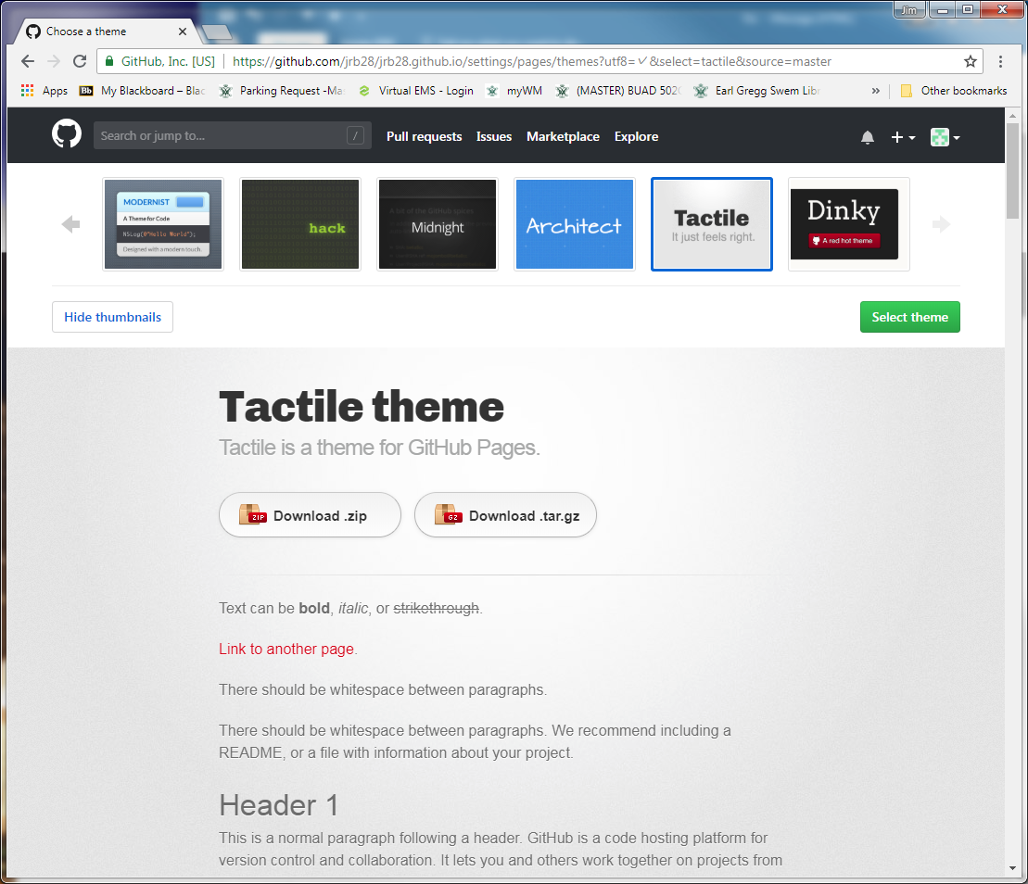
Setting Up the Website
Mode 2 (continued)
Choose theme
Scroll through themes and click on one to select
Right-click and Save Link As…

Slide 24
Setting Up the Website
Mode 2
Unzip zip file
Notice file-folder structure: a complete web site
Upload all files & folders to
github.com/username/username.github.io
Commit Changes
You just created your web site
Remember latency to compile website
Need to customize it

Slide 25
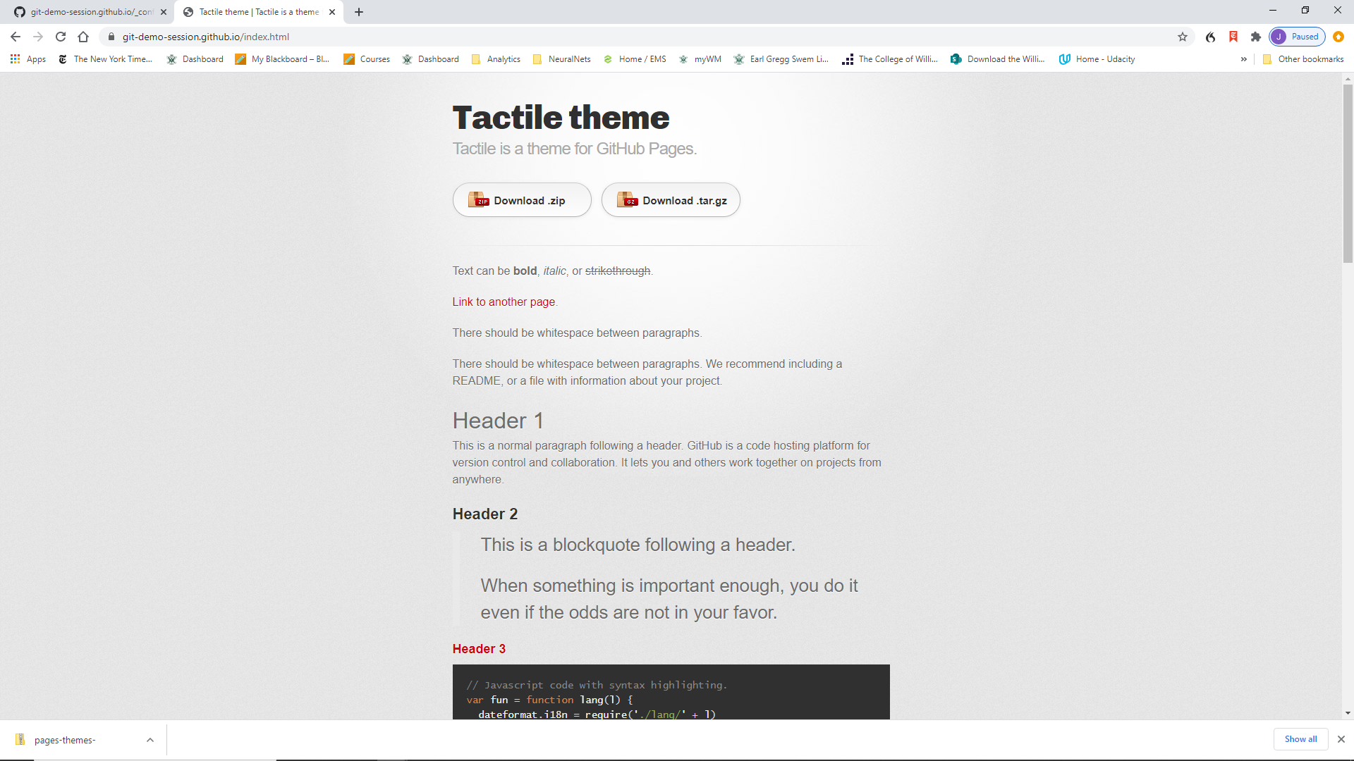
Setting Up the Website

Slide 26
Setting Up the Website
Mode 2
Critical files to edit now
index.md
_config.yml (remove download buttons)
Possibly edit this file later
(if downloaded zip file with Mode 2)
_sass/Jekyll-theme-tactile.scss
Colors, fonts, etc.

Slide 27
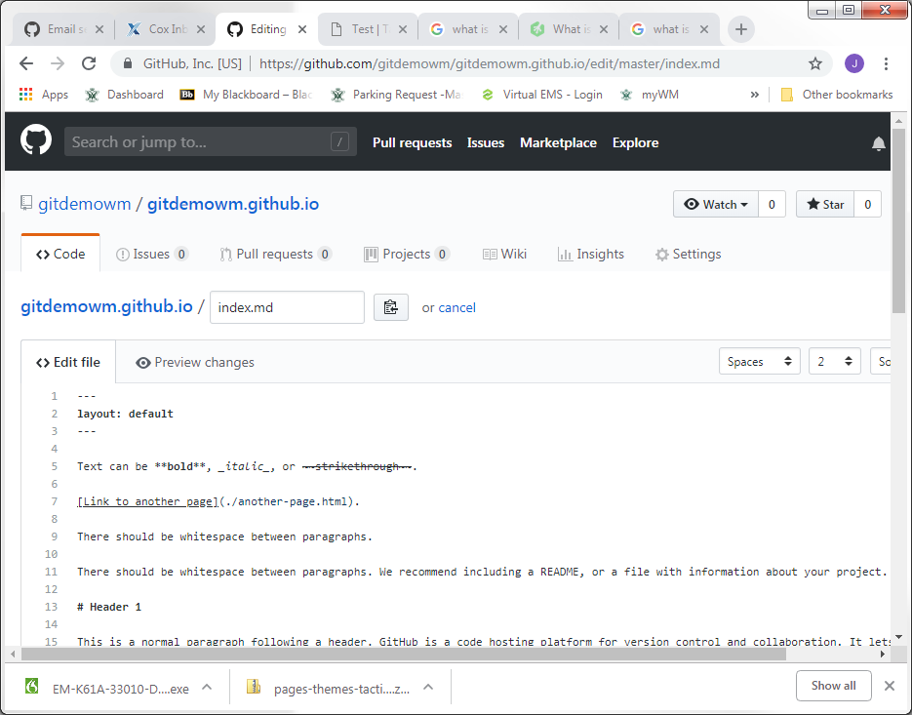
Setting Up the Website
Front Matter
Demarcated by “---” Controls some facets of web page content: Titles, Description, etc.
Markdown Content of web page

Slide 28
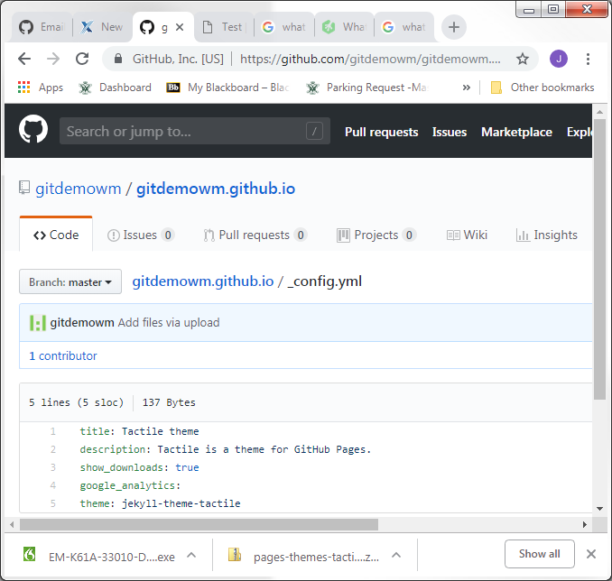
Setting Up the Website
Default Page Settings
Using layout: default in the .md front matter causes document to use all these attributes
Override these settings in .md using commands like: title: My Web Page

Slide 29
Setting Up the Website
View username.github.io again in browser
Note where title and description appear
Note download buttons
Edit index.md using text editor
Edit title and description in front matter
title: Test Title
description: Test Description
index.md must have front matter section
Start and End “---”
Edit _config.yml
Change show_downloads to false

Slide 30
GitHub Personal “Pages” Web Sites
Tour an Example
Setting up the website
Creating content

Slide 31
Website Structures
Link content from index.md in root of username.github.io
Web site default landing page
Web site structure strategies
Organize with folders
Create project or topic web pages from markdown docs
Create separate websites from other repos
Link to a variety of content
Repos (e.g., code), Images, Videos
Jupyter notebooks
For download and visual rendering

Slide 32
Website Structures
Create project or topic web pages from markdown documents
Create project folder in root directory
Create index.md file within that folder
Creates default landing page for that folder
Edit the index.md as desired
Link to the project index.md file from the root index.md file
[Alternate Text](path_to_item)
[Time Series](/timeseries/index.md)
Open index.md in timeseries subfolder of current folder

Slide 33
Portfolio Website on GitHub
Jupyter notebooks
In GitHub web site viewed through web browser
Save .ipynb notebooks as HTML for HTML view
[Jupyter Notebook (html)](TimeSeriesDecomposition.html)
.ipynb files are automatically downloaded otherwise
[Jupyter Notebook (ipynb)](TimeSeriesDecomposition.ipynb)
Jupyter notebooks in repositories
.ipynb files are rendered as HTML
Non-functional, but aesthetically rendered

Slide 34
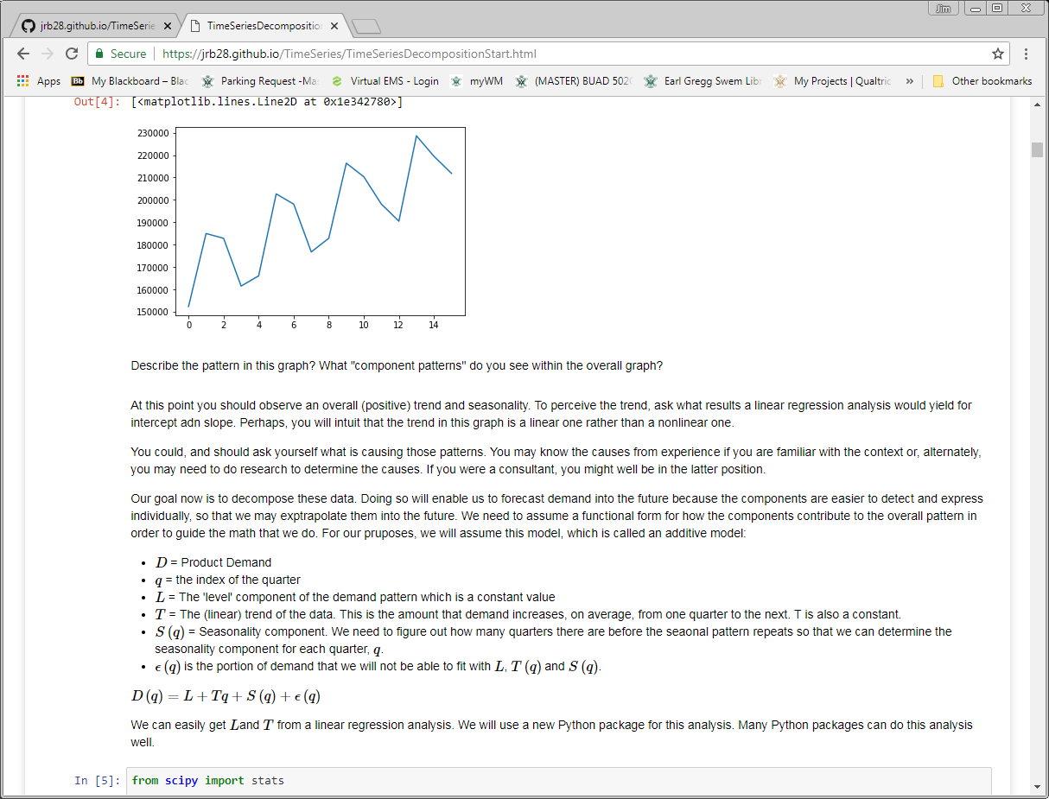
Portfolio Website on GitHub
Jupyter from a GitHub web page
Notice URL indicates .html file

Slide 35
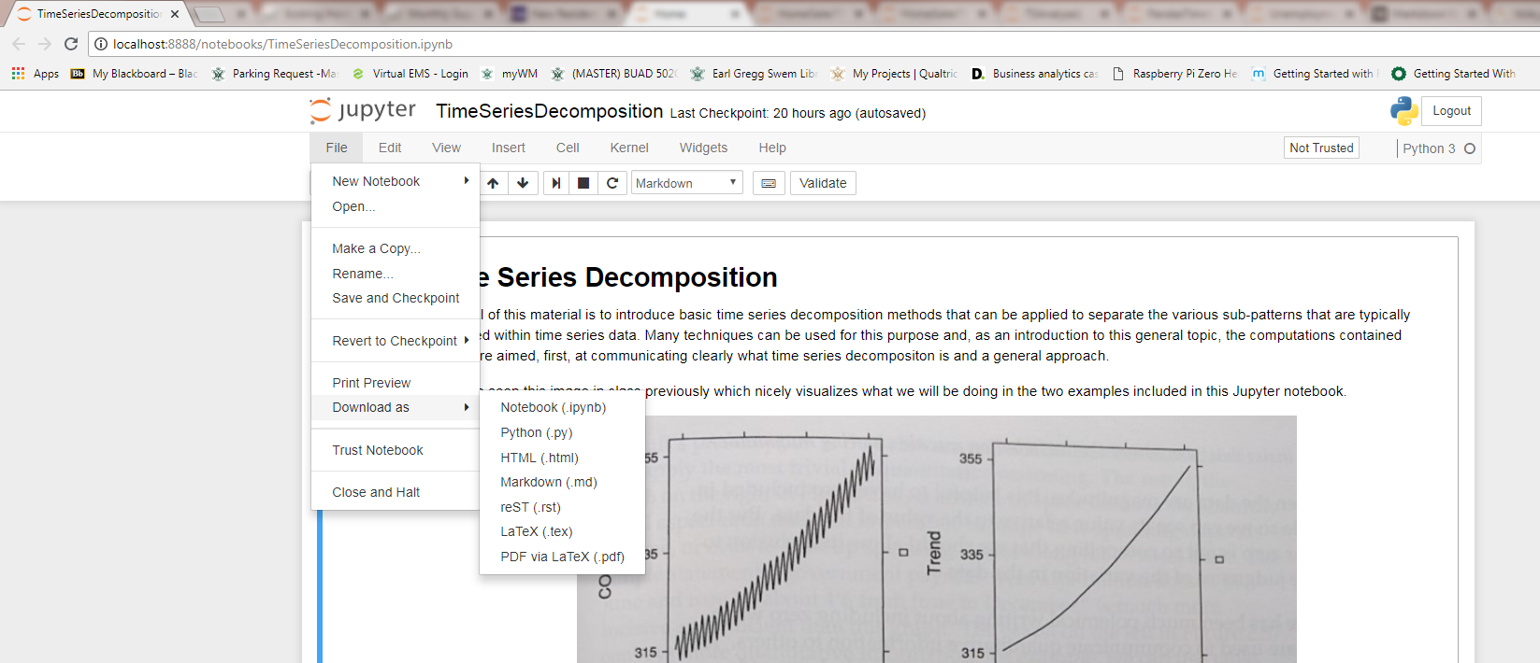
Portfolio Website on GitHub
How to convert Jupyter notebooks to html

Slide 36
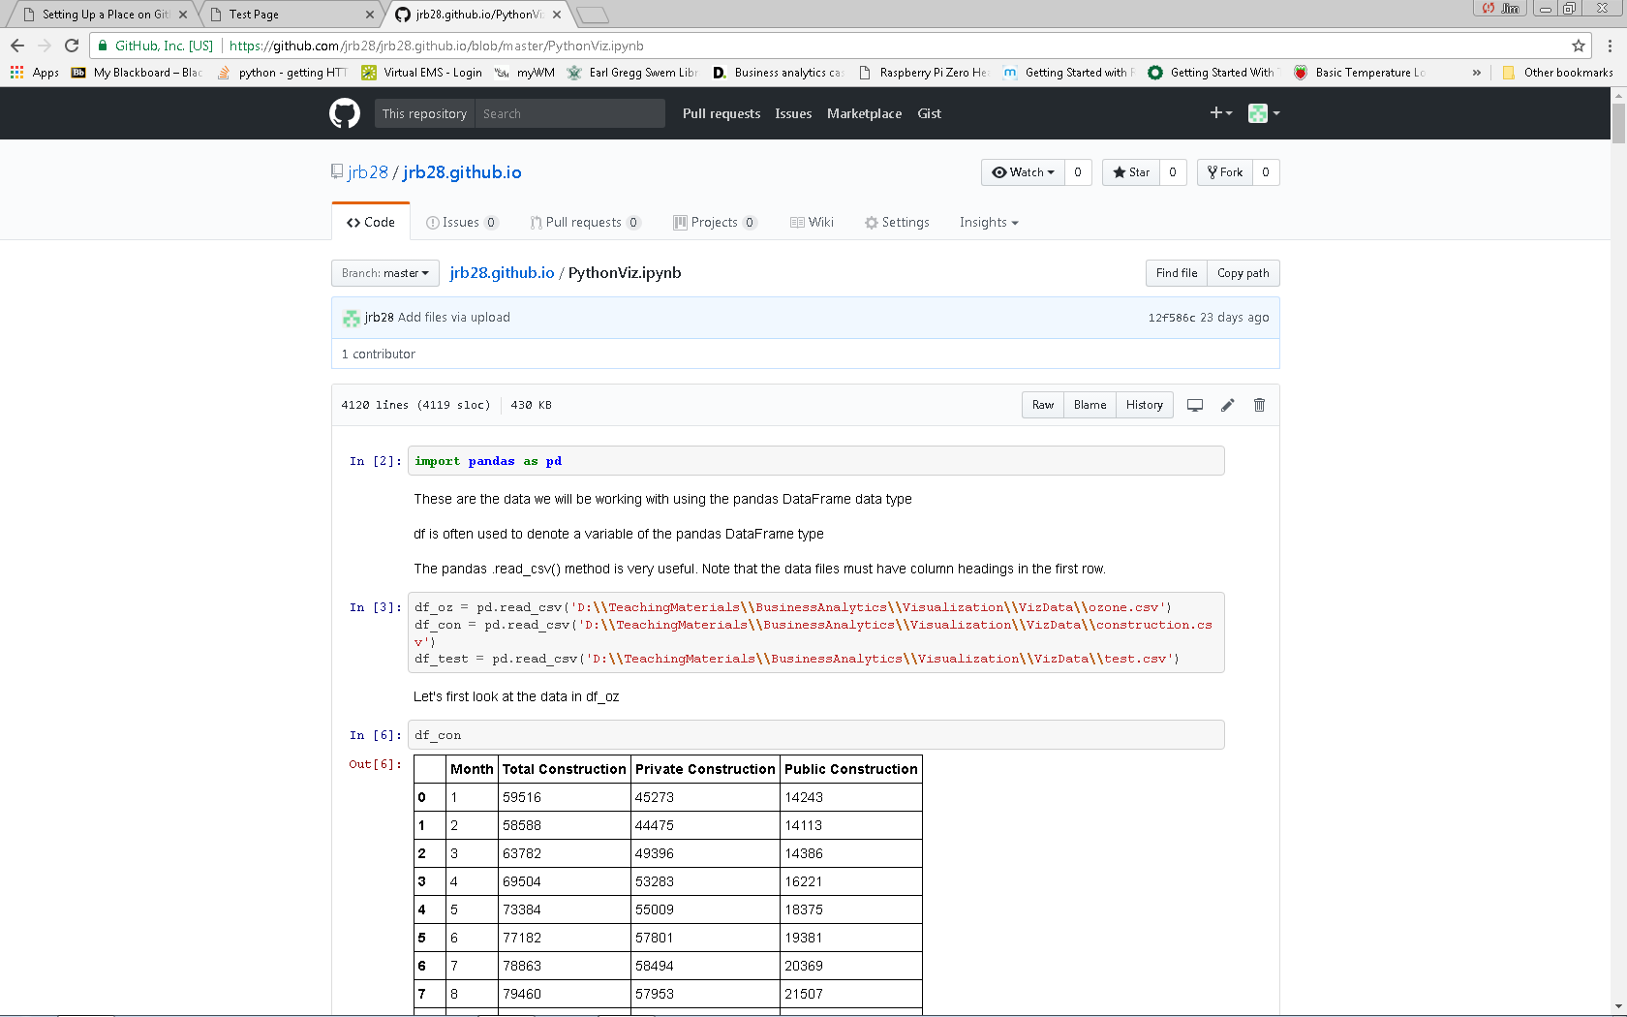
Portfolio Website on GitHub
Jupyter notebooks viewed in repository

Slide 37
Portfolio Website on GitHub
Links to images
![Picture](myPic.jpg)
Assuming image is in same folder
Links to videos on youtube
YouTube video number is 123 in this example
[![Sorting](https://img.youtube.com/vi/123/0.jpg)](http://www.youtube.com/watch?v=123)
Links to repositories
[Repository](https://github.com/username/repo_name)

Slide 38
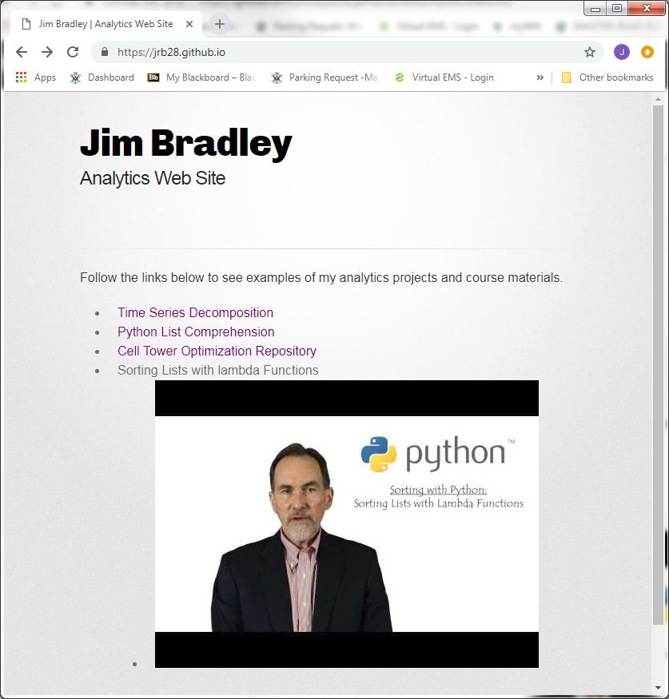
Portfolio Website on GitHub
My website
See repository for link examples

Slide 39
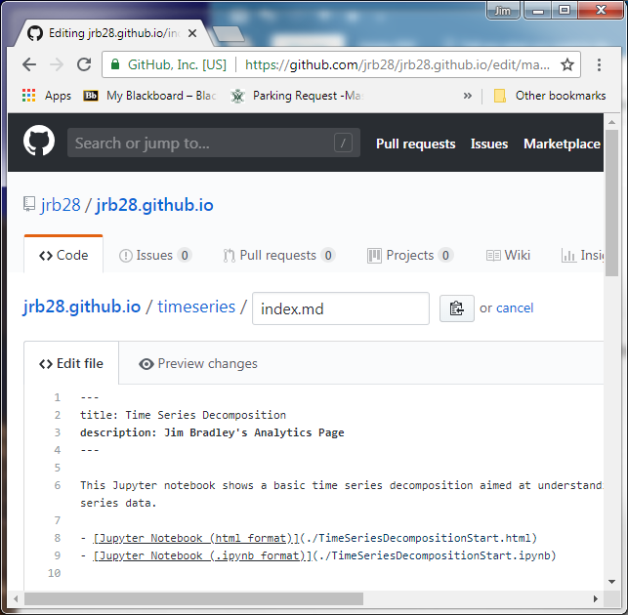
Tips
Each page should have a title and description between the set of three dashes
Edit .scss file in _sass folder to revise format

Slide 40
Tips
There is a lag from when you load files and edit .md files and when they can be viewed online

Slide 41
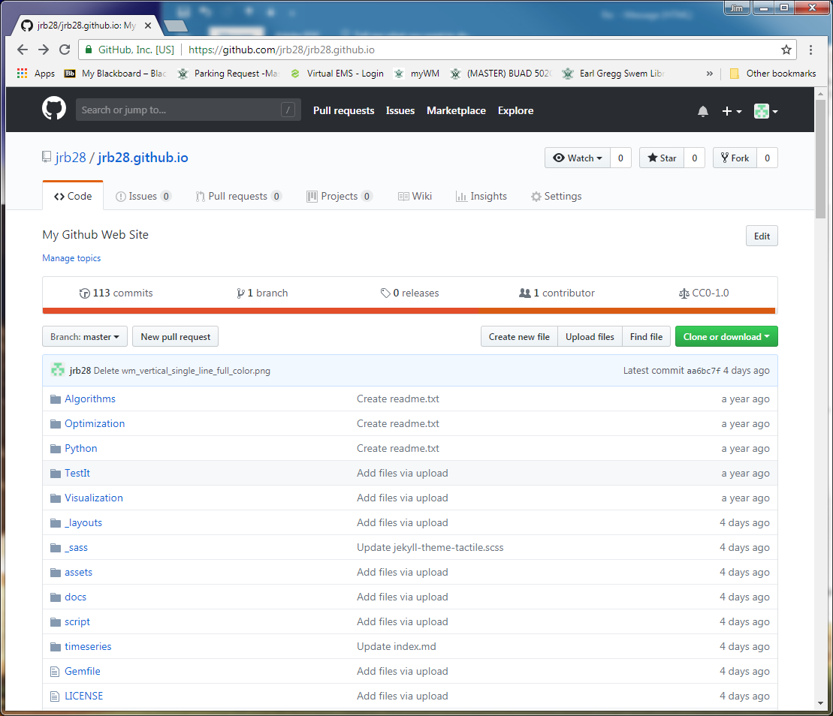
Tips
Manage website
Add files just like other repositories
Uploading content by dragging files from File Explorer to GitHub folder
Commit changes

Slide 42
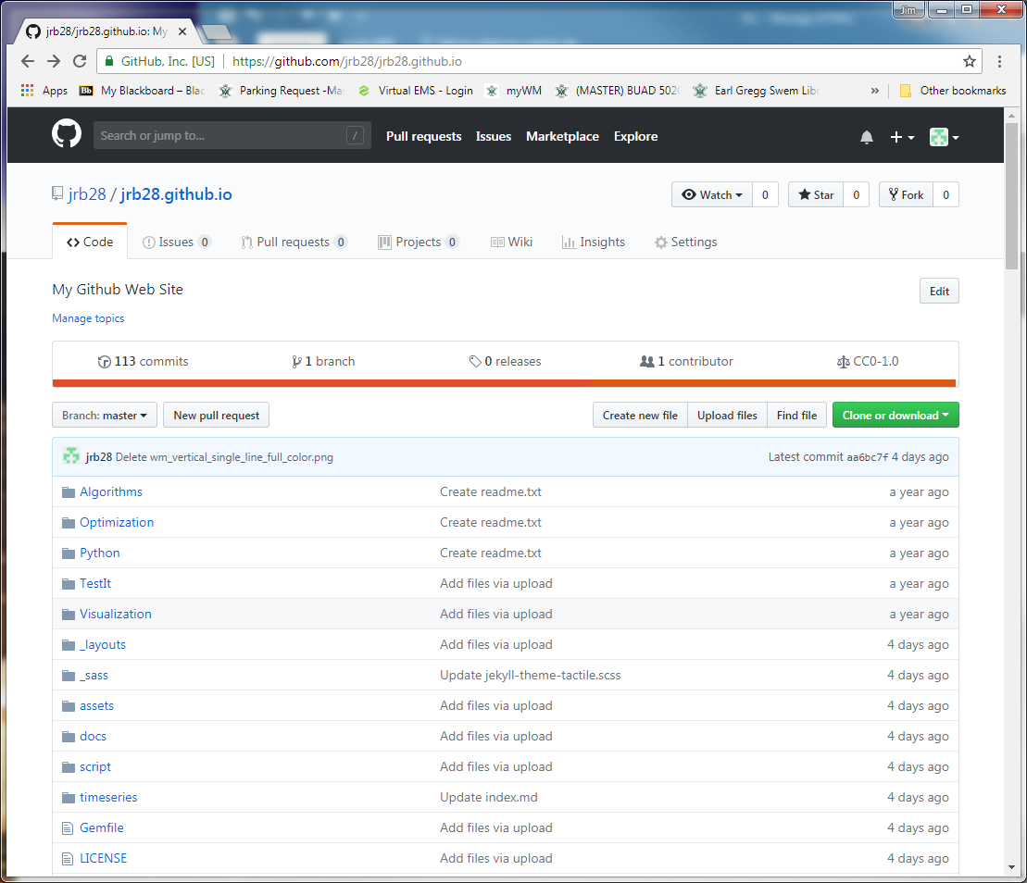
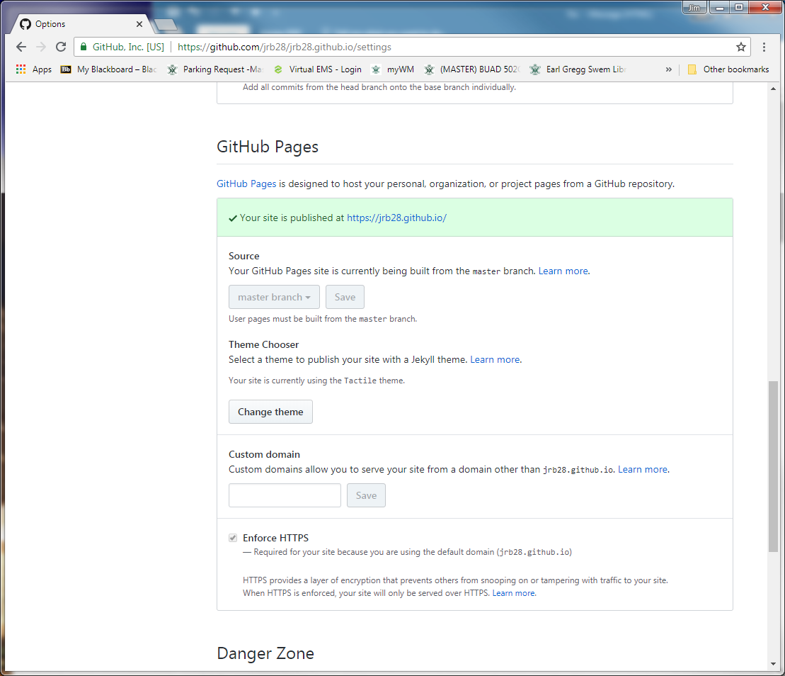
Tips
Change themes

Slide 43
Portfolio Website on GitHub
Resources & Ideas
https://dannguyen.github.io/github-for-portfolios/
See first tutorial for basics of setting up a GitHub web page
http://blog.udacity.com/2016/02/how-to-build-a-data-analysis-portfolio-that-will-get-you-hired.html
https://techbeacon.com/what-do-job-seeking-developers-need-their-github
https://help.github.com/articles/working-with-jupyter-notebook-files-on-github/
https://www.dataquest.io/blog/how-to-share-data-science-portfolio

Slide 44
Advanced Techniques

Slide 45
Advanced Topics for Later
Use GitHub Desktop App
Manage website content
Make another repo into a website

Slide 46
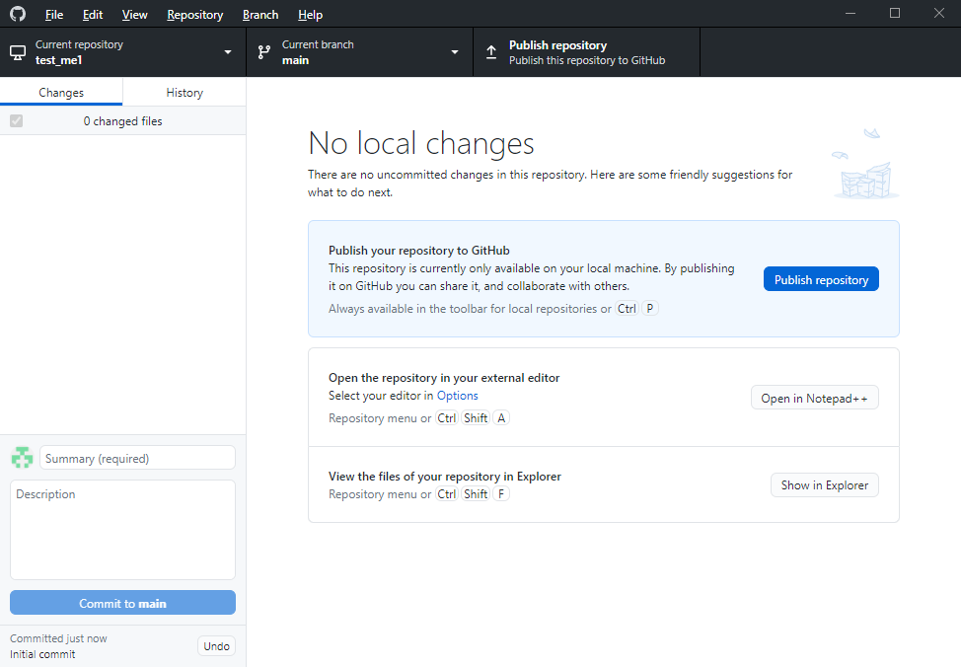
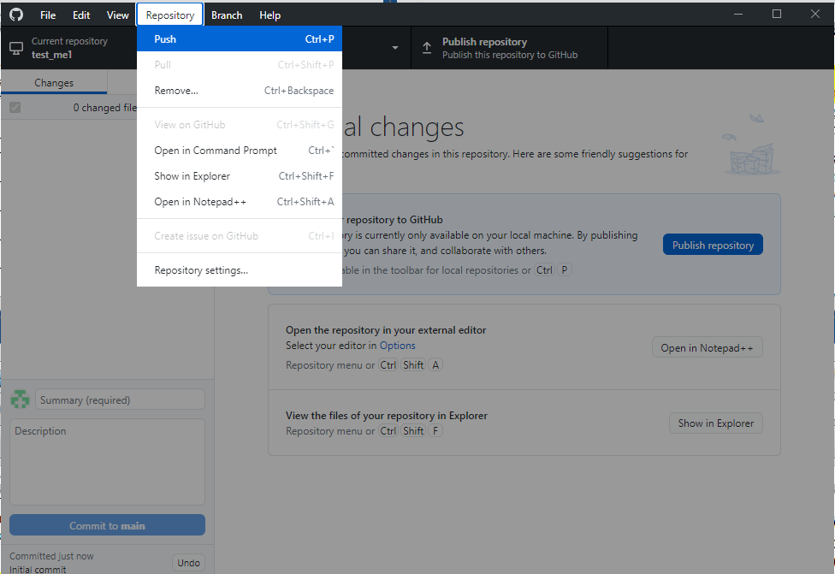
GitHub Desktop App
Create repo
File>New repository
Publish repo on GitHub.com
Click Publish Repository button
(or) Repository>Push

Slide 47
GitHub Desktop App
Work on content on desktop GitHub folder
Commit Changes on desktop
Push changes to GitHub.com

Slide 48
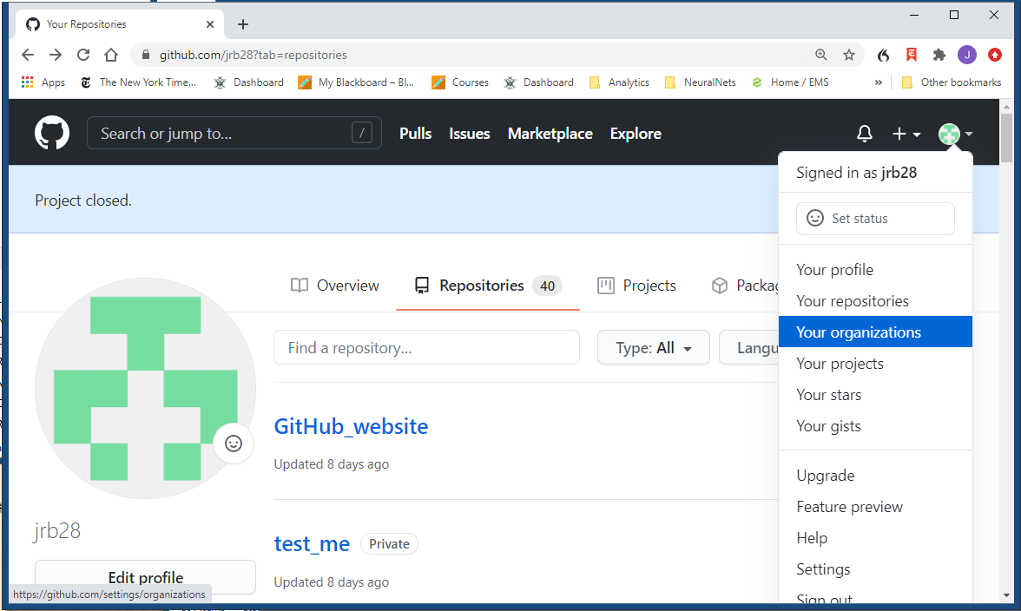
GitHub Organizations
Convenient to collaborate
Also, there are teams within organizations

Slide 49
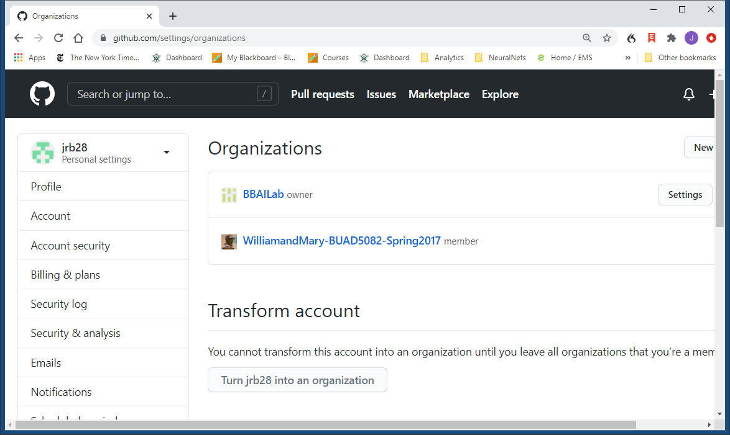
GitHub Organizations

